Slide 1
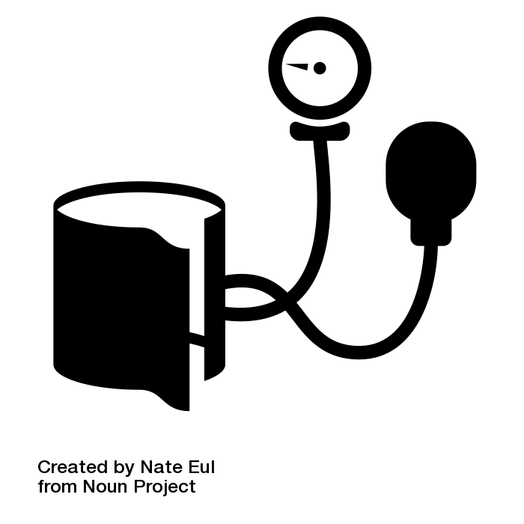

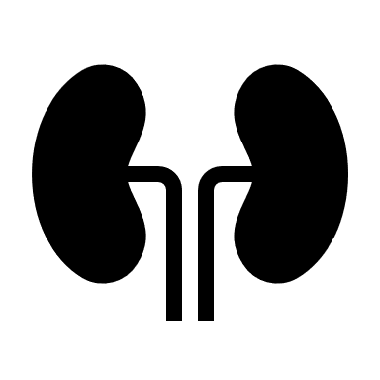




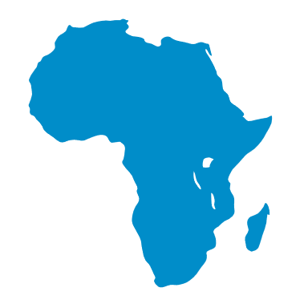
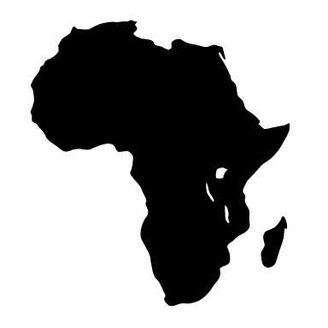
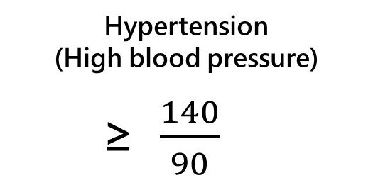
Is your Blood Pressure Too High?
Hypertension
(High blood pressure)
≥ $\frac{140}{90}$
Why it matters
Premature death
Increases risk for diseases like:
Heart
Kidney
Brain
Affects 1.13 BILLION worldwide
Who’s Especially at Risk?
1 in 4 Males
2 in 3 Low- and Middle- Income Countries
25 by 2025!
Decrease hypertension by 25% worldwide
https://www.who.int/news-room/fact-sheets/detail/hypertension

